Slide 1

Day 0: Software Developer Job Roadmap
Introduction
Notes:
Photo by Mark König on Unsplash

Slide 2
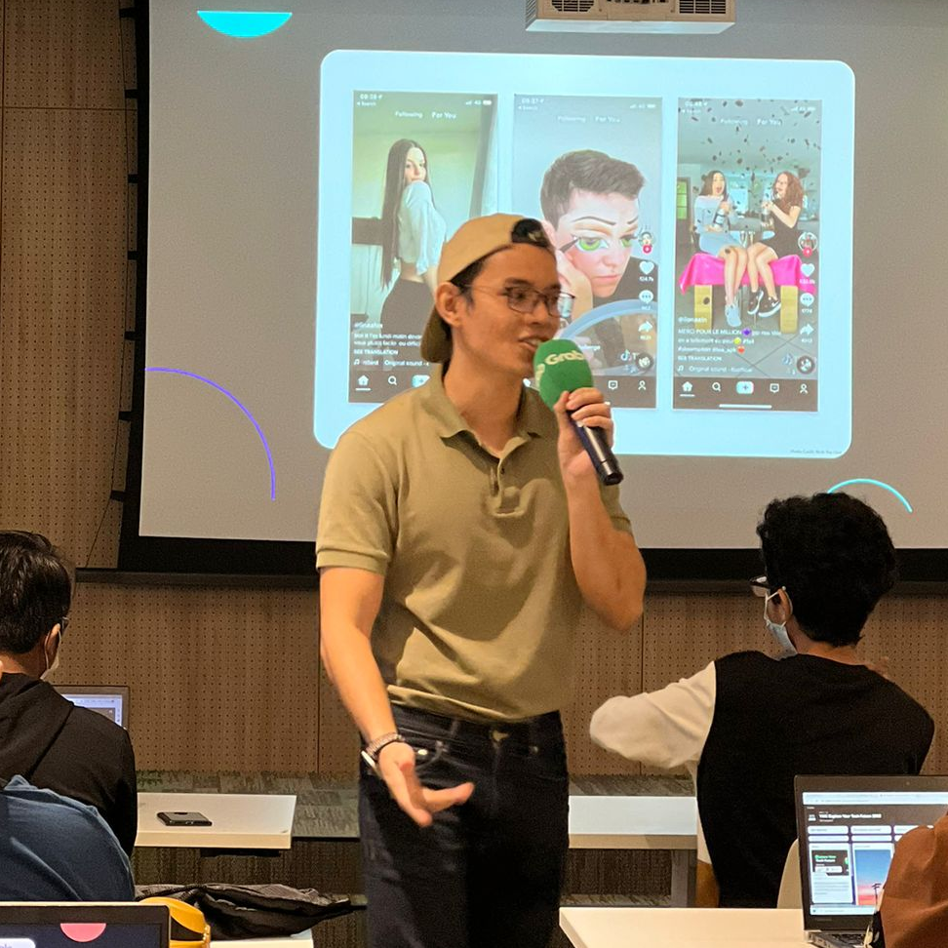
Introduction
Hi all! My name is Haris. Currently, general partner in Sigma.
Before this, was a uni dropout turned software developer through a coding bootcamp.
I will be your instructor for this course!
I have taught in Nanyang Technological University, Singapore Manage University and more. You will be in safe hands, I think.

Slide 3

In this course, you will learn
- The reality of becoming a software developer
- The roadmap to become a software developer
- How to build simple beginner friendly projects to get started
All in 7 hours in 7 days! 1 hour a day. Dayummm. Do note that this course is an introductory course.

Slide 4
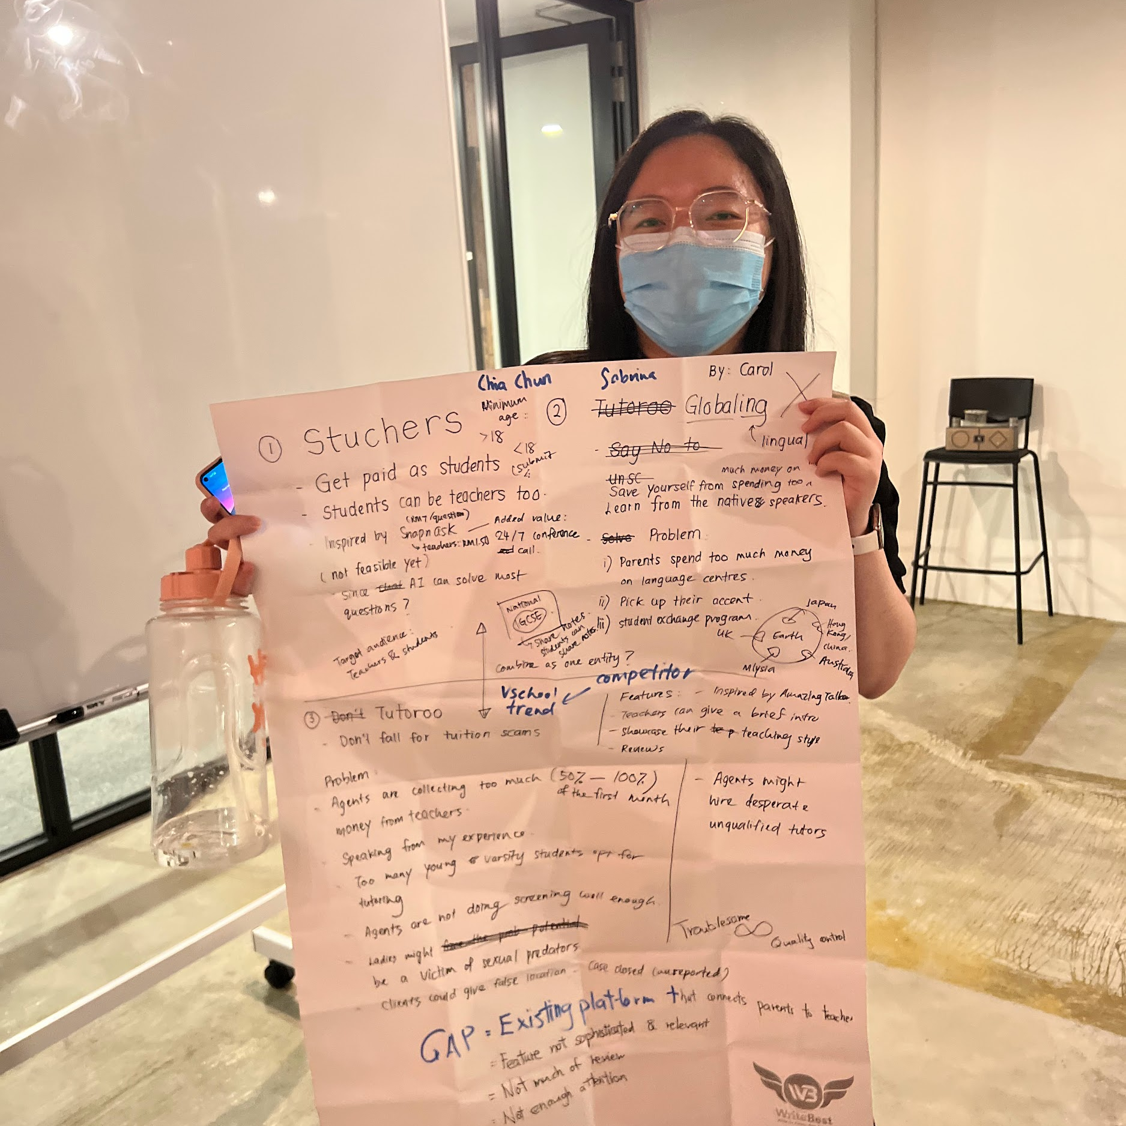
No coding experience needed!

Slide 5
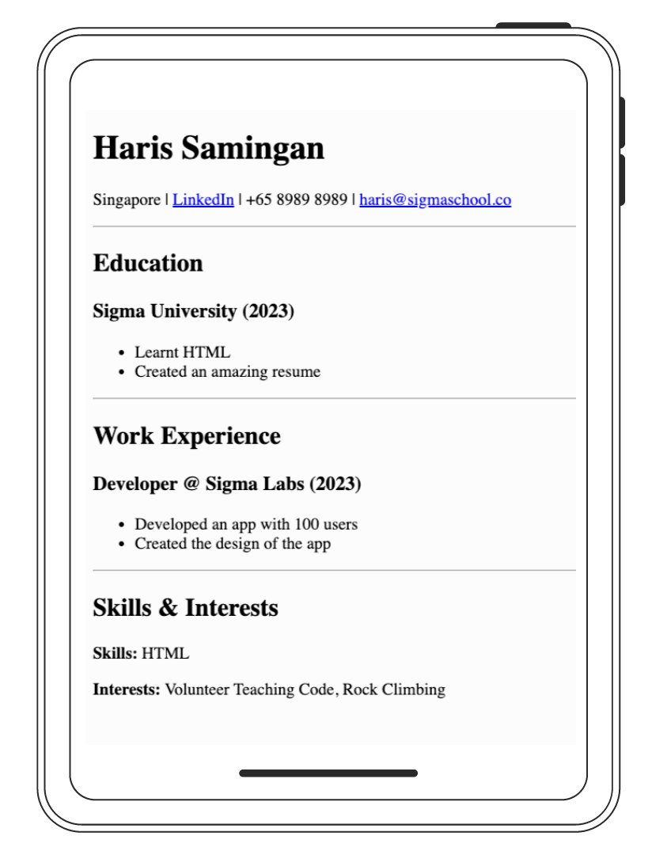
You get to build a resume website!

Slide 6
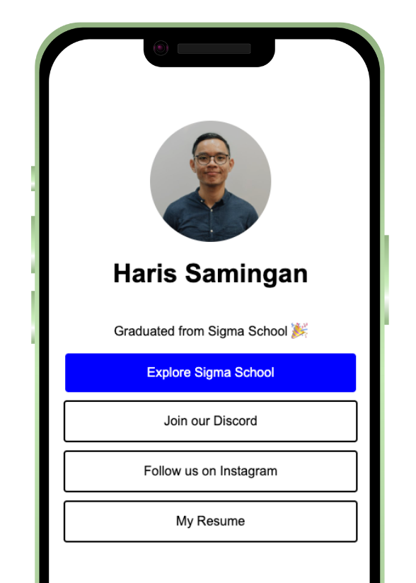
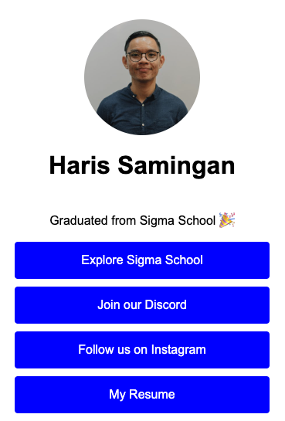
And a link in bio clone!

Slide 7
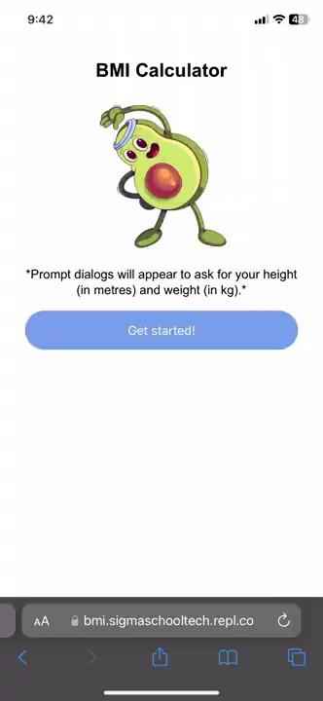
And a BMI calculator!

Slide 8
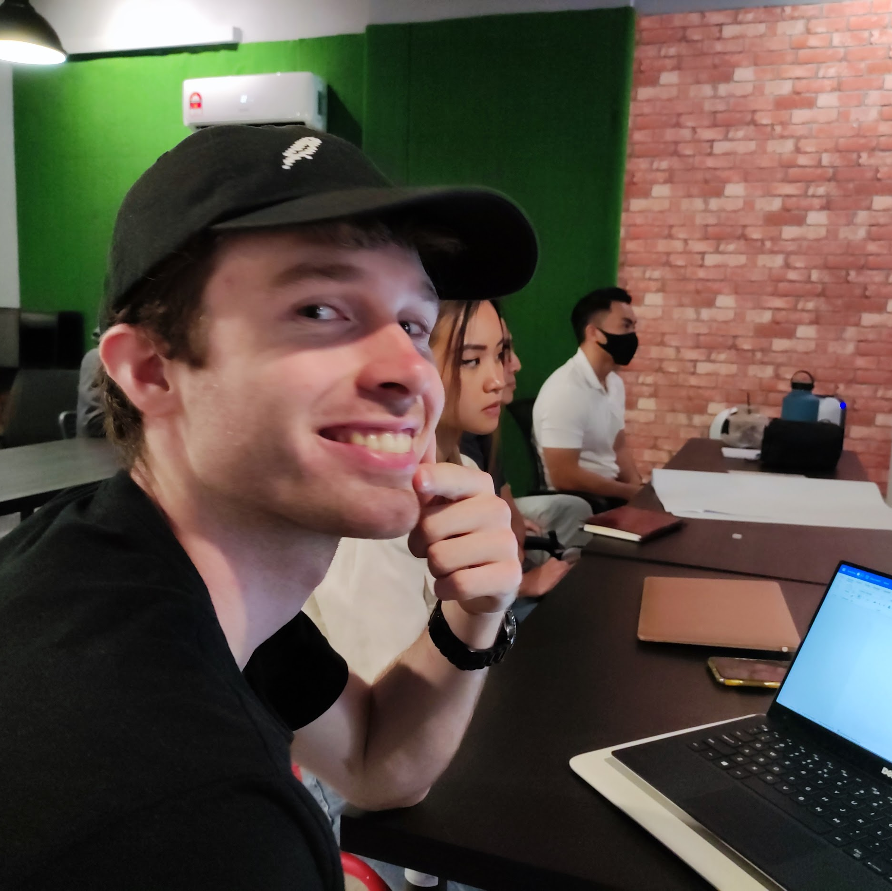
You are not alone!
Join our discord community with 100+ members.
You can meet like-minded people, ask questions and get the support you need.
Link for discord:
https://discord.gg/yCrB7tfbhg
You can also get a free t-shirt by gaining points.
Luckily, you get points when completing this course!

Slide 9
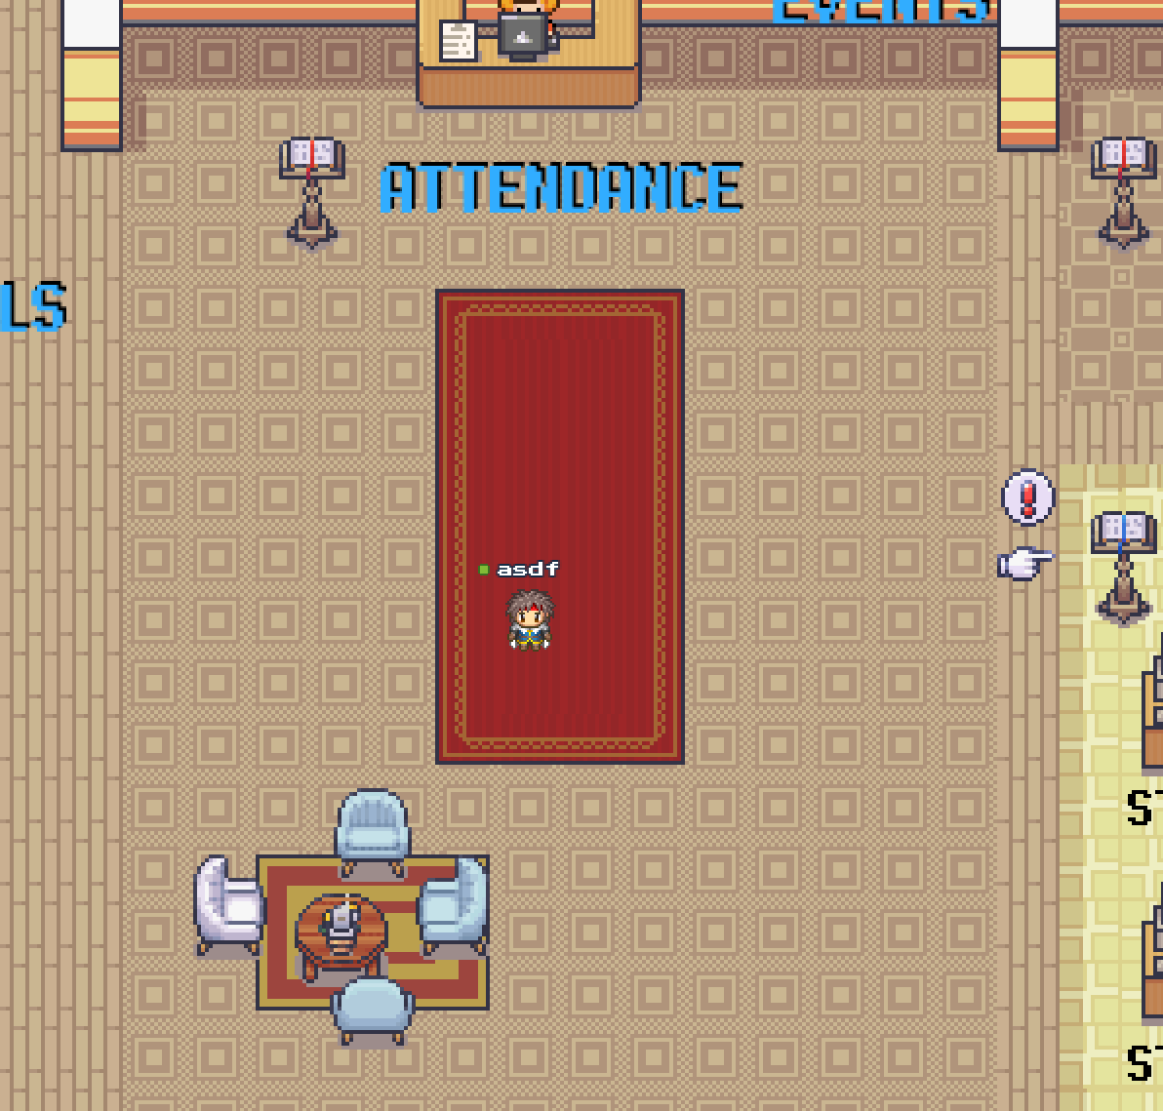
Online Universe
Moreover, we also have an online universe.
No, it’s not VR/AR. We don’t have budget, yet.
But it will be as good!
We call it Sigmaverse. This is where you can hangout and meet other people as well!
The link to join: cbe.sigmaschool.co

Slide 10

We have another free course
Just letting you know, we have an additional FREE course as well, called Coding Basics Experience.
You: Wow, this is amazing
Me: I know. Your welcome.
Link here: https://app.sigmaschool.co/spaces/7456888?utm_source=manual
It is also beginner friendly, mainly in HTML/CSS.

Slide 11
How we teach in this course
It is mainly self paced.
No videos where it’s too fast for you.
No small text that is very hard for you to see.
It is slides that gives the step by step.
And our proven way to teach is…

Slide 12
Way of teaching
Tell you what we are building
Show you the code you need to create project
Run the code to see if it work
Get curious on the code with our detailed explanation
Repeat step 2 to 4
Finish project with excitement!

Slide 13
Course outline

Slide 14


Your 6-Day Success Plan
We are currently here
Day 0 (30 mins):
Roadmap to Software Dev
Learn the pros of being software dev
Learn the step by step to be software dev

Slide 15
Your 6-Day Success Plan
Day 1 (1h):
Learn creating a website using HTML
Create Your First Website
Understand how websites understand HTML
Use HTML to create links & texts
Build a resume website

Slide 16
Your 6-Day Success Plan
Day 2 (1h):
Learn to style a website using CSS
Styling Websites
Add your profile picture for employers!
Learn to create buttons and design them
Build a Link in Bio project

Slide 17
Your 6-Day Success Plan
Day 3 (1h):
Learn data types such as numbers & strings
Build Interactive Website
Understand how to store data in variables
Learn how to show data
Create BMI calculator

Slide 18
Your 6-Day Success Plan
Day 4 (1h):
Learn to get user inputs
Better BMI
Understand how to make website interactive
Create better BMI calculator

Slide 19
Your 6-Day Success Plan
Day 5 (1h):
Learn how to create a list of quotes
Random Quote Generator
Show the quotes randomly
Create random quote generator

Slide 20
Your 6-Day Success Plan
Day 6 (1h):
Learn how to know if answer is correct
Quiz App
Show if the user got it right or not
Create quiz app

Slide 21
Reality of a Software Dev

Slide 22
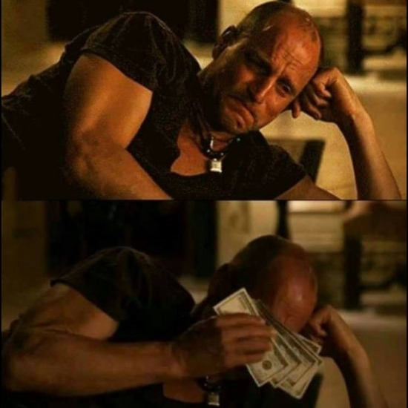
Salary
This is from my personal experience.
A lot of software developers complained about their salary.
I asked them how much they earn.
$5000/month at least. And that is not enough for them.
Me cry in broke tears.
But that is the reality of software dev salary.

Slide 23

Work life balance
This is also from my personal experience.
Software developers, from my experience, has a good work life balance.
Best part, remote work is always possible.
I had a project from a US client.
Total earned: USD$3600
I work in Singapore.
Notes:
Photo by Thought Catalog on Unsplash

Slide 24

High demand
This is also also from my personal experience.
In Singapore, there is 6000+ junior software developers positions.
Junior software developers requires little to no work experience.
The demand is high.
Like a good looking person.
Difference is that you can work towards it.
Notes:
Photo by Martin Adams on Unsplash

Slide 25
Reality of Becoming a Software Dev

Slide 26

Nothing great is easy
I am not going to say it’s easy.
It’s going to be stressful.
It will take a lot of time.
It will take effort.
But, rewarding.
Notes:
Photo by Tim Gouw on Unsplash

Slide 27
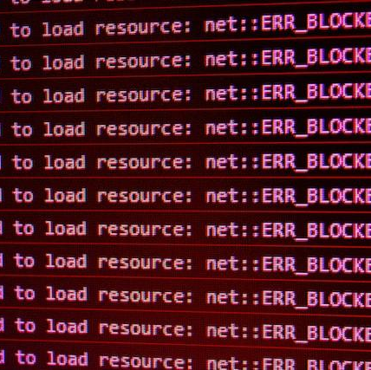
You will face a lot of errors and issues
When learning programming, you will encounter errors and issues.
This is part of being a software developer.
However, as a beginner, this might be something new to you.
Notes:
Photo by David Pupaza on Unsplash

Slide 28
Roadmap of Becoming a Software Dev

Slide 29

Step 1: Master the Basics
This is where you learn to walk.
If your basics is not stable, you would have a harder time learning difficult concepts.
Don’t worry, in this course, we will go through the basics to build a project.
I will share with you in more detail what are the basics you need to master
Notes:
Photo by Alyssa Stevenson on Unsplash

Slide 30

Master the basics
- We cover in this course
Variables, Integer, Strings
Functions
Git & GitHub
If else, conditionals
Arrays, Index
For loops
Object Oriented Programming

Slide 31

Step 2: Build simple web projects
You should always apply what you have learnt. What other way to do it is with building websites!
Web development is the most visual way to learn, as we humans are visual learners.
In this course, we also go through the a few basics
In the next slide, I will share what web concepts you should learn and project ideas to you can get started with.
Notes:
Photo by Wes Hicks on Unsplash

Slide 32
Build simple web projects
- We cover the basics in this course
HTML/CSS
Document Object Model
Modules
Resume Project
Link in Bio Project
BMI Calculator
Password Generator Project
Calculator Project
Quote Generator

Slide 33

Step 3: Build web projects with frameworks
Frameworks are basically blue prints.
The purpose is to make development faster and easier.
The most popular web framework to learn is React.
The most popular styling framework to learn is Bootstrap.
Notes:
Photo by Ashkan Forouzani on Unsplash

Slide 34
Build web projects with frameworks
React
Hooks, useState
Bootstrap
React Router
Create, Read, Update, Delete
Instagram Clone

Slide 35

Step 4: Build web projects with databases
Building projects on your own is good.
Building projects for others is better.
Databases is important to store data.
Here is a list of topics on what to learn, and project to do.
Notes:
Photo by benjamin lehman on Unsplash

Slide 36
Build web projects with databases
Node.js
API
async/await
SQL
Express.js
Twitter Clone

Slide 37

Step 5: Build web projects with web services
Heard of AWS (Amazon Web Services)?
Imagine, doing login code, database code, and analytics code, which is 100s line of code, but in a few lines of code.
That’s what web services does, simplifying the complicated logic.
More companies nowadays are using these services for faster building of tech products.
Here’s a list to learn.
Notes:
Photo by Carlos Muza on Unsplash

Slide 38
Build web projects with databases
Firebase
Firestore Database
Firebase Authentication
Firebase Storage
Hosting
Data Analytics Dashboard Project

Slide 39

Step 6: Prepare and apply for jobs
You should have a huge amount of projects that you have built.
This will give you the confidence to apply for the dream job: TikTok star.
I mean software developer.
These are the list to do to increase your chances to get a software developer job!
Notes:
Photo by Van Tay Media on Unsplash

Slide 40
Prepare, and apply for jobs
Create LinkedIn Profile
Create Resume
Create Portfolio Website
Practice Data Structure & Algorithm
Practice Interview Skills
Applying through LinkedIn and Job Portals
Network at meetups and events

Slide 41
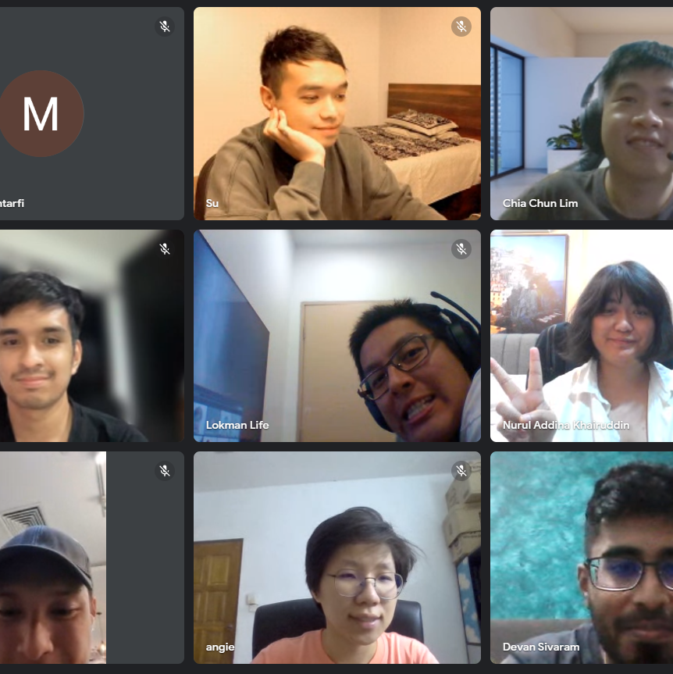
In Sigma School, we cover 100% of the roadmap!

Slide 42

How long would this take?

Slide 43
Learning software dev
* like Sigma School
University
(3-4 years)
Self study
(6 months to 2 years)
Bootcamps*
(3 to 6 months)

Slide 44
Summary
You have learnt on the step by step on what concepts and projects you should aim for.
You also learnt the pros and cons of of being a software developer.
Hopefully this inspires you to start the change.
Information is potential energy.
Let’s convert it to kinetic energy in the next day, where you will build a resume website!

Slide 45

Gain points!
Now that you have completed this module, you can gain points by doing this survey:
https://forms.gle/FJzRxgVw7fS2DMPY9
You can gain up to 16 points!
Currently, you can get a free Sigma T-shirt for 150 points.
There will be more freebies in the future ~
Not real. Picture is for illustration purposes.

Slide 46

Day 0 completed!

